Slide 1
Image compression using K-means clustering
Seminar 06/14/2021
Class: CS232.L21.KHCL
Instructor: Ph.D. Vinh Tiep Nguyen

Slide 2
About us
Nguyễn Lê Anh Quân - 19522081
Dương Đình Thắng – 19522195
Lợi Mai Công Trung - 17521174

Slide 3
Table of contents
Image Compression
K-means clustering algorithm
K-means clustering in image compression
Demo
Conclusion

Slide 4
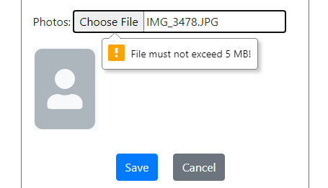

Image compression
❓ Question: Problem when using our image on the Internet
How can I reduce the size of this image?

Slide 5
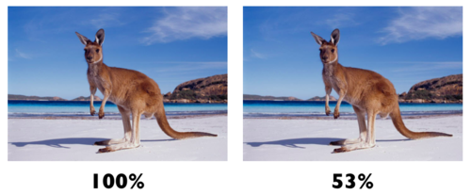
Image compression
❓ What is image compression?
⤷ A type of data compression applied to images without degrading the quality of the image to an unacceptable level.
Image before and after compression
1: https://support.cloudflare.com/hc/en-us/articles/360000607372-Using-Cloudflare-Polish-to-compress-images

Slide 6
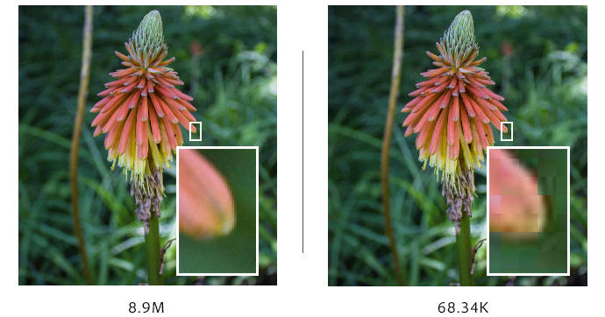
Image compression
❓ What is image compression?
Difference between original image and compressed image
2: https://helpx.adobe.com/photoshop-elements/key-concepts/compression.html

Slide 7
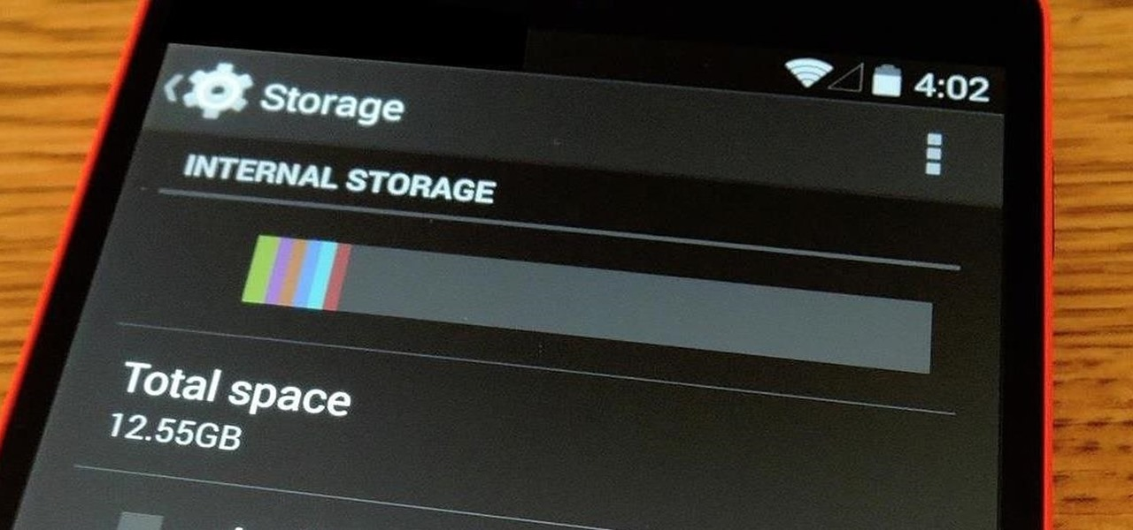
Image compression
❓ Why image compression?
More free space in the storage
3: https://android.gadgethacks.com/how-to/free-up-storage-space-android-keep-from-getting-full-0154716/

Slide 8
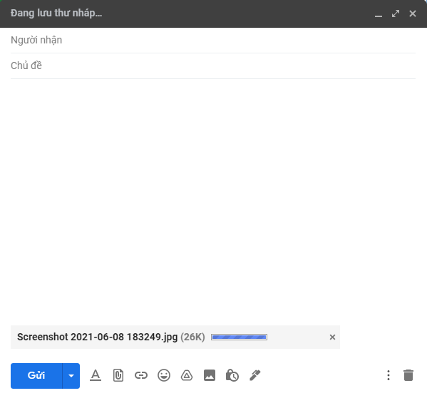

Image compression
❓ Why image compression?
Reduce time required for images to be sent over the Internet or download.

Slide 9

Image compression
❓ Why image compression?
Reduced web pages loading time
4: https://vikashtech.com/2020/blog/how-to-improve-website-page-speed/

Slide 10
Image compression
❓ How image compression works?
How do we approach image compression?
Lossless compression
Lossy compression

Slide 11
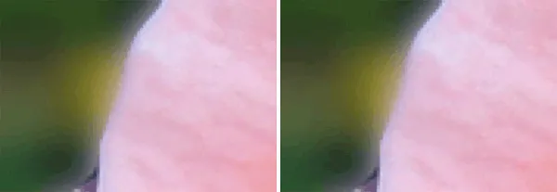
Image compression
👀 Lossless compression
⤷ Reduces the size of the image while maintaining the same quality as its original form.
⤷ Higher quality => bigger size.
Clarity of images before and after lossless compression
5: https://www.maketecheasier.com/how-image-compression-works/

Slide 12
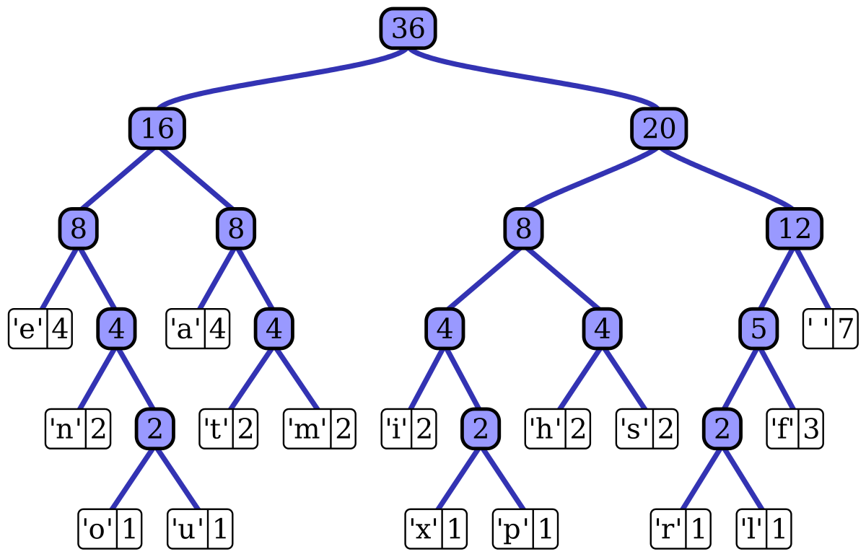
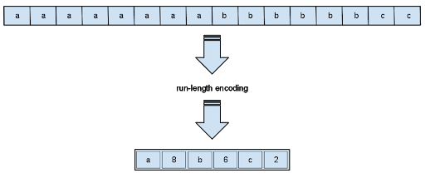
Image compression
👀 Lossless compression algorithms
Run-length encoding
Huffman encoding
6: http://www.stoimen.com/tag/lossy-compression/
7: https://en.wikipedia.org/wiki/Huffman_coding

Slide 13
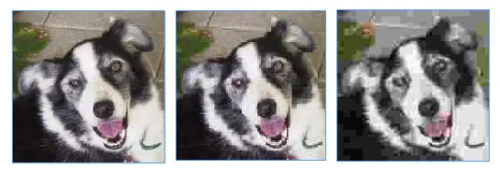
Image compression
👀 Lossy compression
⤷ Reduces image size by getting rid of unimportant data, thus cannot be restored to its original form.
⤷ Lower quality => smaller size.
Clarity of images before and after lossy compression
8: https://www.maketecheasier.com/how-image-compression-works/

Slide 14
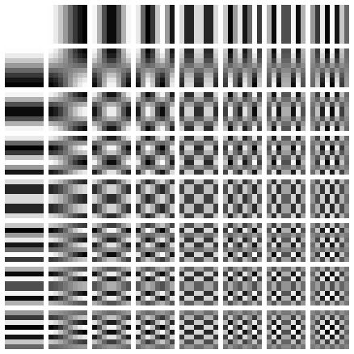
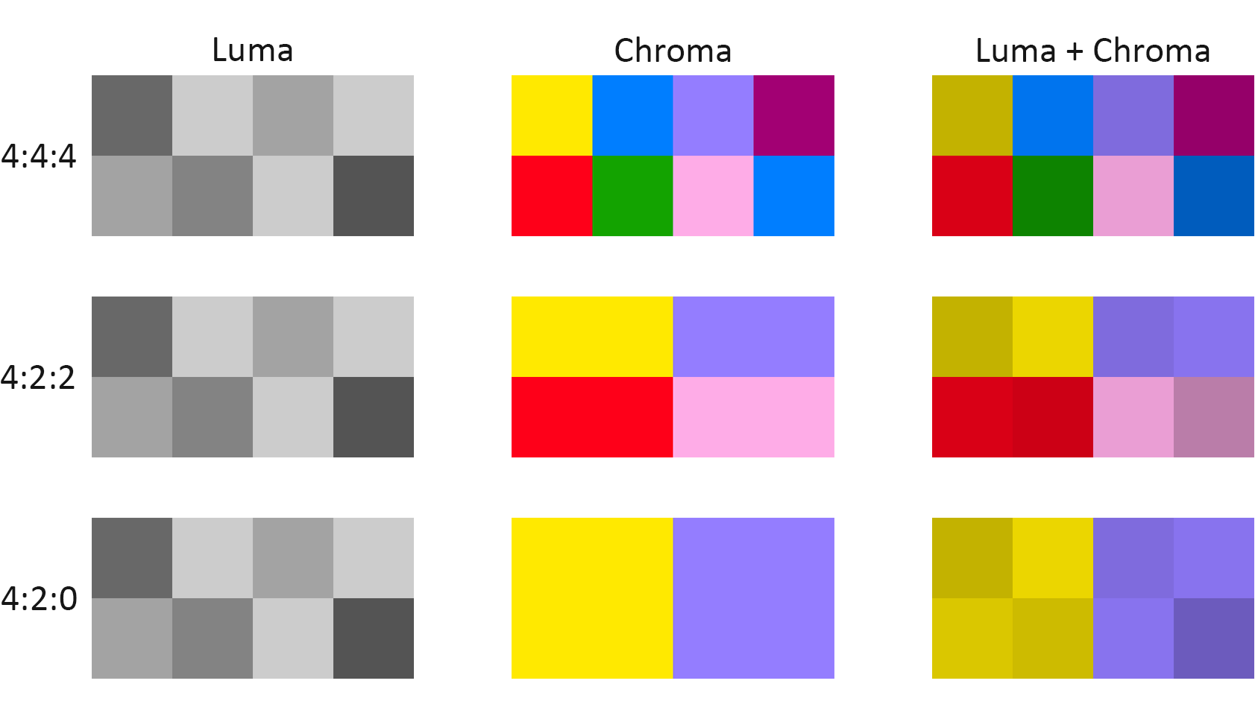
Image compression
👀 Lossy compression algorithms
Chroma subsampling
Transform coding
9: https://www.maketecheasier.com/how-image-compression-works/
10: https://www.rtings.com/tv/learn/chroma-subsampling

Slide 15
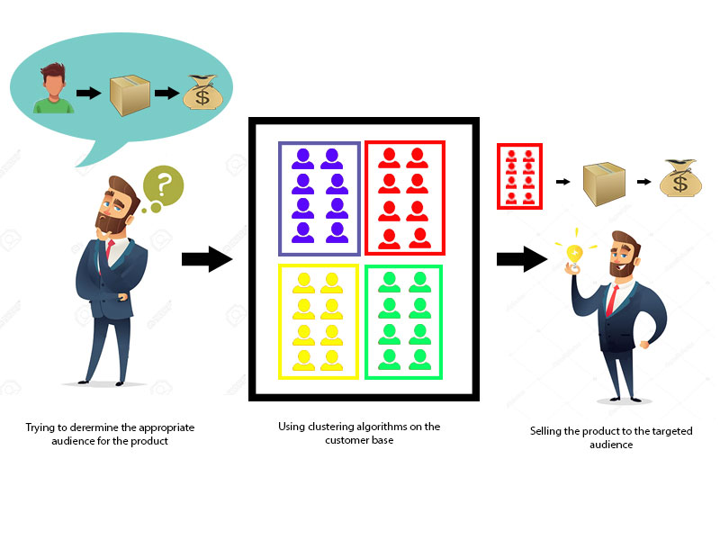
II. K-means clustering algorithm
❓ Clustering problem?
11: https://www.javatpoint.com/data-mining-cluster-analysis

Slide 16
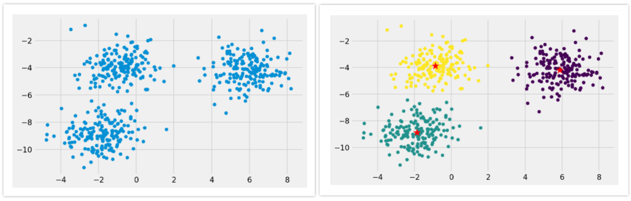
II. K-means clustering algorithm
❓ What is K-means clustering?
⤷ A centroid based clustering technique.
⤷ Cluster dataset into k different clusters.
⤷ Each cluster is represented by its centroid point.
13: https://towardsdatascience.com/image-compression-using-k-means-clustering-aa0c91bb0eeb

Slide 17
II. K-means clustering algorithm
❓ How K-means clustering work?
Initialization: randomly picked k-centroids point from dataset.
Assignment: for each point in dataset, compute distance with all centroids, the point will be assigned to the cluster with the nearest centroid.
Update centroid points: update centroid value with new mean value.
Repeat step 2 and 3 until convergence or until the end of a fixed number of iteration

Slide 18
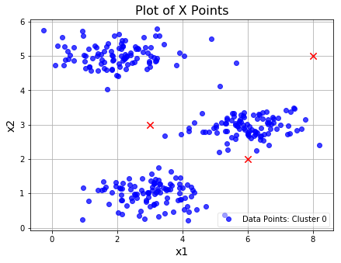
II. K-means clustering algorithm
❓ How K-means clustering work?
Initialization
Initialize the dataset and select k = 3
Randomly pick 3 points on the dataset to become centroid.

Slide 19
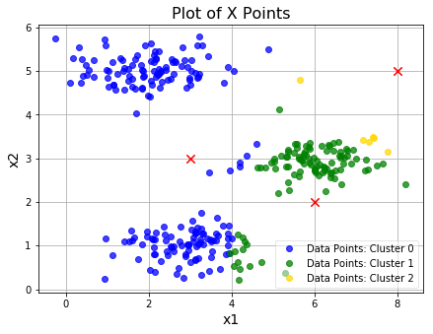
II. K-means clustering algorithm
❓ How K-means clustering work?
2. Clustering
Assign all data points to their cluster by the nearest centroid

Slide 20
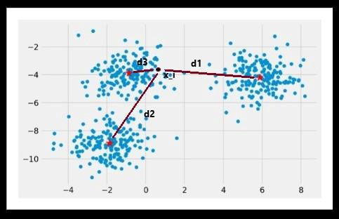
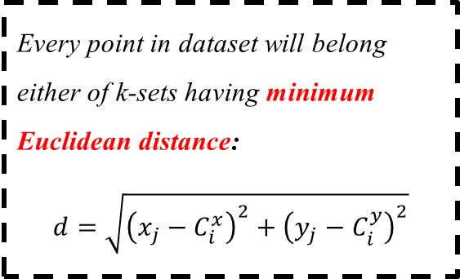
II. K-means clustering algorithm
❓ How K-means clustering work?
15: https://medium0.com/m/global-identity?redirectUrl=https%3A%2F%2Ftowardsdatascience.com%2Funderstanding-k-means-k-means-and-k-medoids-clustering-algorithms-ad9c9fbf47ca

Slide 21
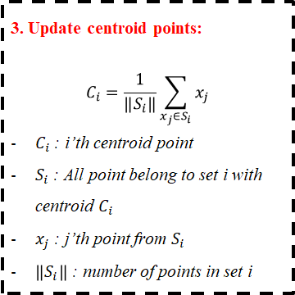
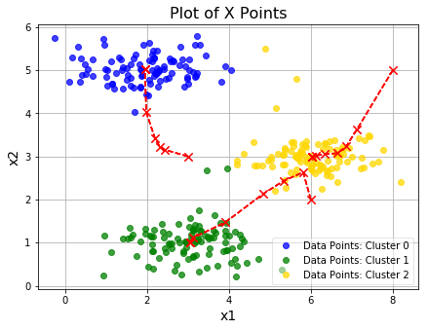
II. K-means clustering algorithm
❓ How K-means clustering work?

Slide 22
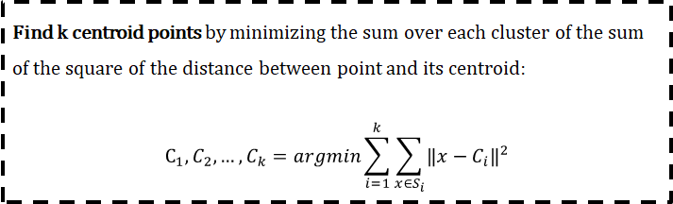
II. K-means clustering algorithm
❓ How K-means clustering work?
⤷ When will convergence happen? => Optimize the lost function
Notes:
The idea of the K-Means algorithm is to find k centroid points (C_1, C_1, . . . C_k) by minimizing the sum over each cluster of the sum of the square of the distance between the point and its centroid.
This cost is NP-hard and has exponential time complexity. So we use the idea of approximation using Lloyd’s Algorithm.

Slide 23
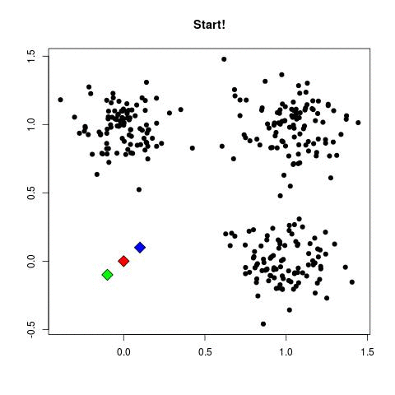
II. K-means clustering algorithm
❓ How K-means clustering work?
16: https://towardsdatascience.com/k-means-clustering-introduction-to-machine-learning-algorithms-c96bf0d5d57a

Slide 24
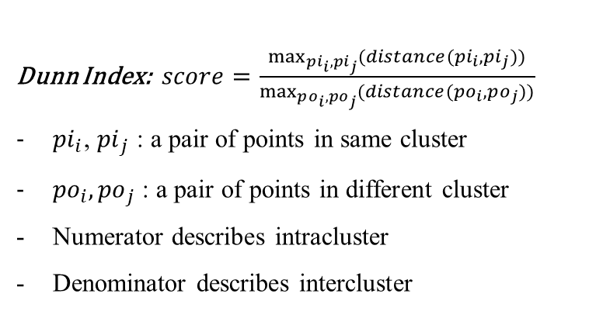
II. K-means clustering algorithm
👀 Metric for evaluating clustering performance
⤷ Suppose we have a set of n data point p
_ Intracluster distance: distance between two points in the same cluster
_ Intercluster distance: Distance between two points in the different cluster.

Slide 25
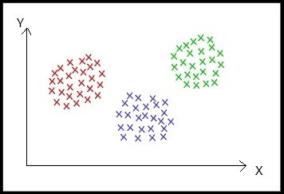
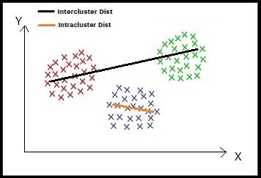
II. K-means clustering algorithm
👀 Metric for evaluating clustering performance
12: https://laptrinhx.com/machine-learning-clustering-algorithm-2431293740/

Slide 26
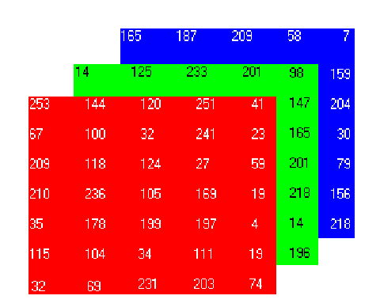
III. K-means clustering in image compression
👀 About image
Ranged from 0 to 255
Total number of colors: 16.777.216
17: https://www.researchgate.net/figure/A-three-dimensional-RGB-matrix-Each-layer-of-the-matrix-is-a-two-dimensional-matrix_fig6_267210444

Slide 27
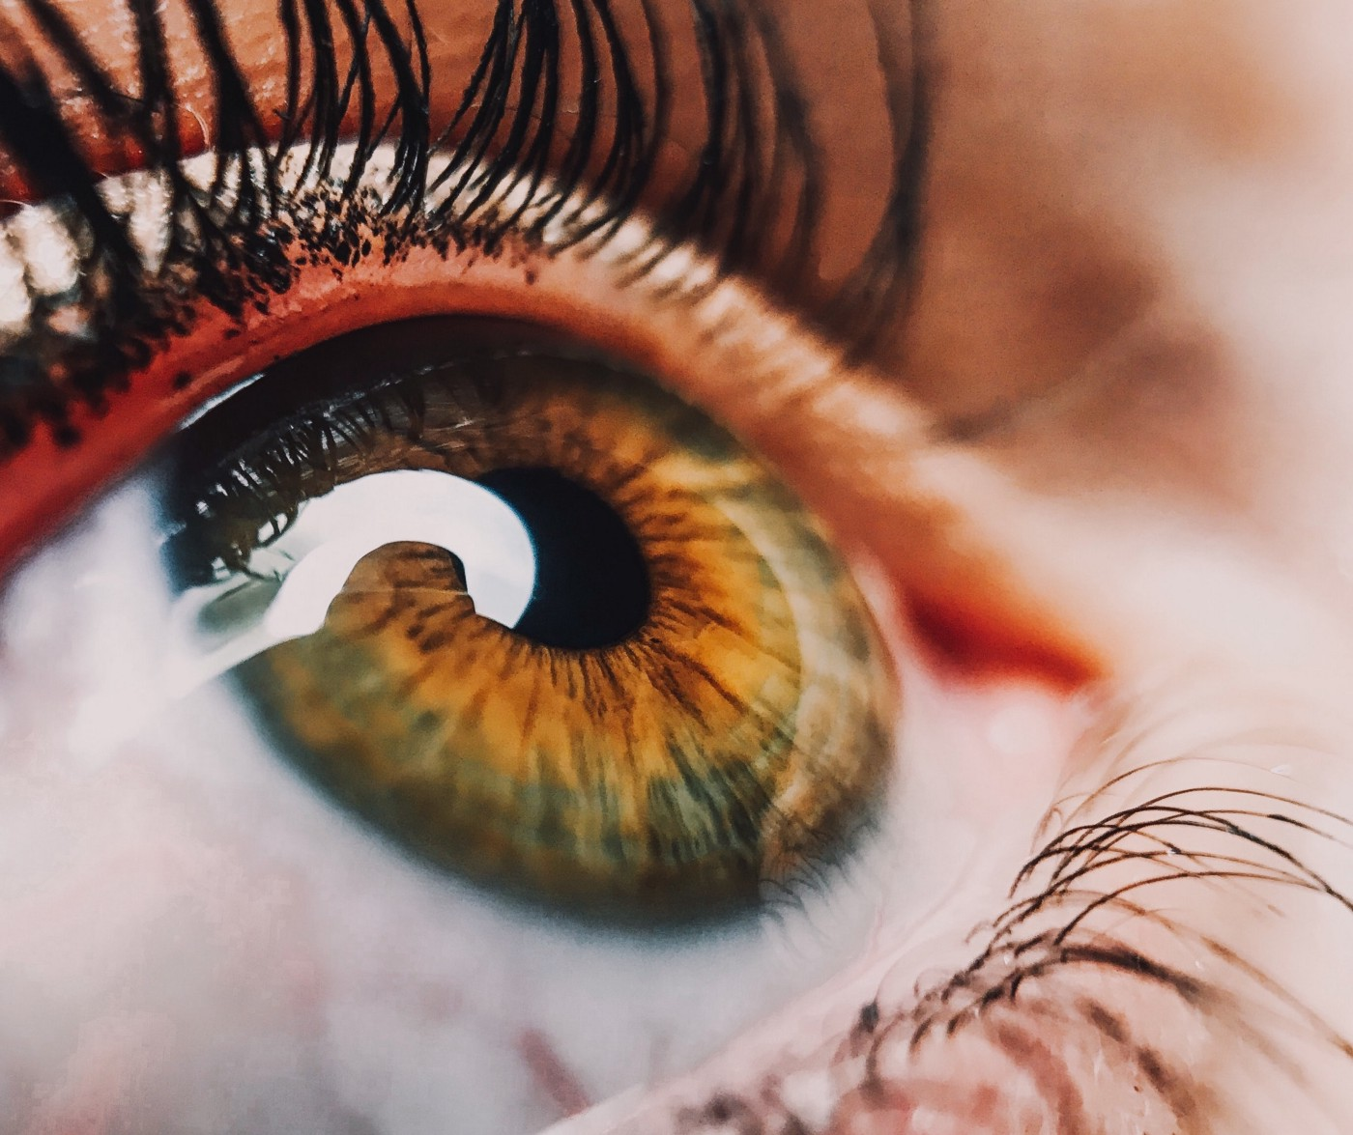
III. K-means clustering in image compression
👀 About image
Total number of colors: 16.777.216
Group similar looking colors
Colors having different intensity values that are RGB values seem the same to human eye
Notes:
Mày có thể nói vì hay lý do kể trên nên ta có thể rút ra được rằng: có thể giảm bớt số lượng màu mà một ảnh có thể hiển thị để giảm bớt size dữ liệu lại.

Slide 28
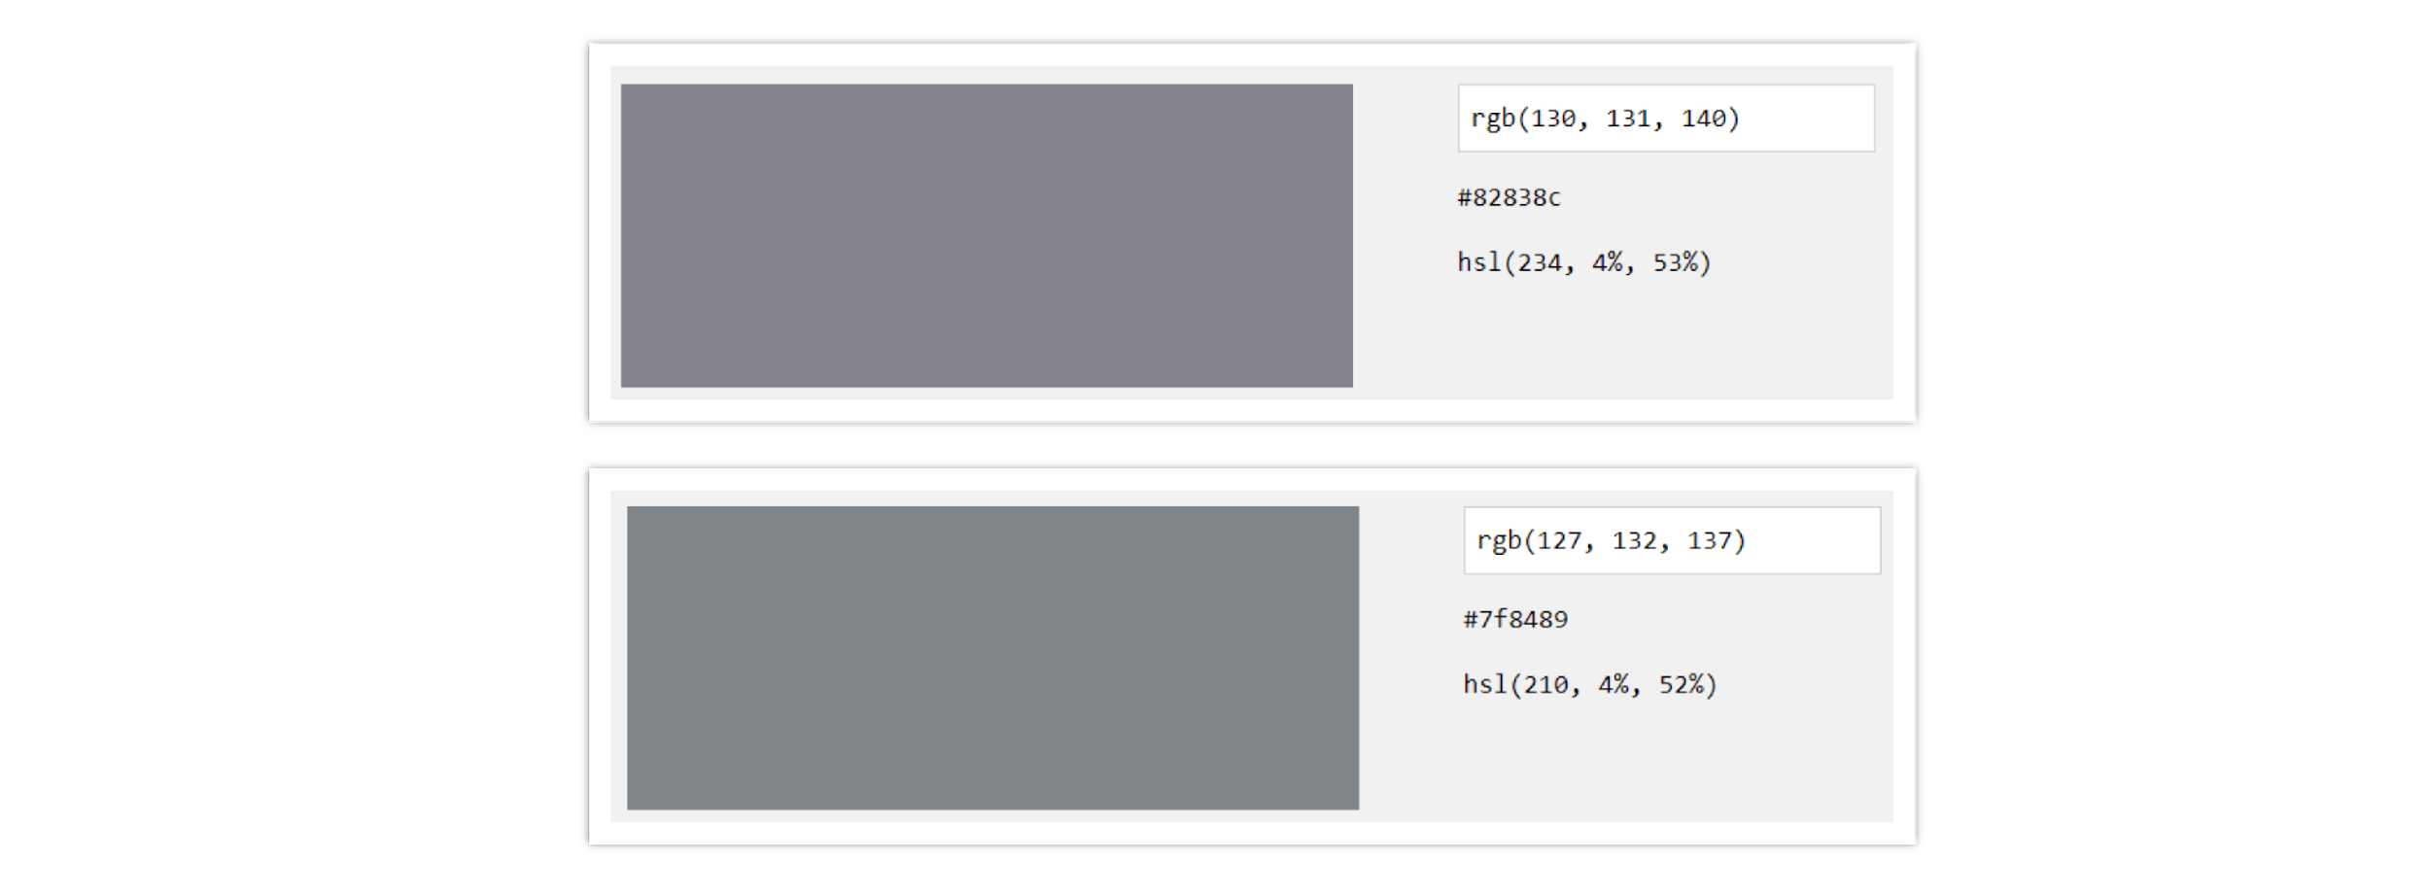
III. K-means clustering in image compression
👀 About image
Colors with different intensity but same in human eye
18: https://towardsdatascience.com/image-compression-using-k-means-clustering-aa0c91bb0eeb

Slide 29
III. K-means clustering in image compression
👀 Concept
Select k (represents the number of colors in the image), which k < total pixels of the image.
Pick k different points randomly from the image as initial centroid points.
Consider each pixel as a data point, assign them to the closest centroid using Euclidean distance (clustering part).
Compute the new centroids by taking the mean of all pixels that belong to the cluster.
Repeat step 3 and 4 until it converges.
Storing centroid and its index of each pixel.

Slide 30
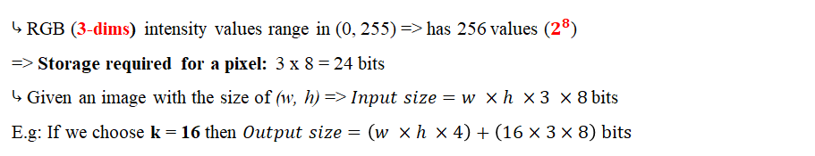
III. K-means clustering in image compression
👀 Compress ratio

Slide 31
III. K-means clustering in image compression
Advantage | Disadvantage
Relatively simple to implement Scales to large datasets. Guarantees convergence. Can warm-start the position of centroids. Easily adapts to new examples. Generalizes to clusters of different shapes and sizes, such as elliptical clusters. | Choosing k manually Being dependent on initial values. Clustering data of varying sizes and density. Clustering outliers Scaling with number of dimensions.
14:https://developers.google.com/machine-learning/clustering/algorithm/advantages-disadvantages

Slide 32
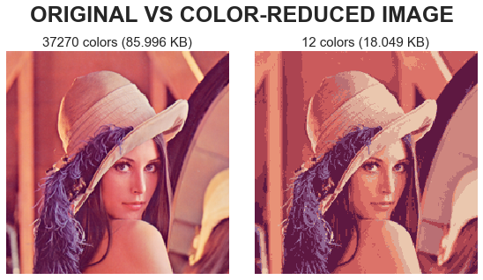
III. K-means clustering in image compression
❓ Optimal k-value?
⤷ How to reduce as much memory size of an image as possible but still maintain most of its origin?
OPTIMAL K - COLORS
19: https://medium0.com/analytics-vidhya/image-compression-using-k-means-clustering-and-principal-component-analysis-in-python-893fd37e8e15

Slide 33
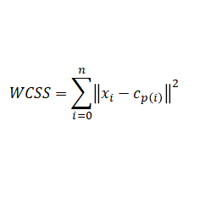
III. K-means clustering in image compression
👀 Elbow method
⤷ Within-Cluster-Sum of Squared Errors (WCSS): the sum of squared Euclidean distance of all the points within a cluster to its centroid.
⤷ Elbow method: calculate WCSS for each k value then choose the k with the smallest WCSS.
N : the number of data points
x_{i}: the i’th data, a 3D vector of RGB value
c_{p(i)}: the cluster centroid of data i’th
Notes:
Within-Cluster-Sum of Squared Errors sounds a bit complex. Let’s break it down:
The Squared Error for each point is the square of the distance of the point from its representation i.e. its predicted cluster center.
The WSS score is the sum of these Squared Errors for all the points.
Any distance metric like the Euclidean Distance or the Manhattan Distance can be used.

Slide 34
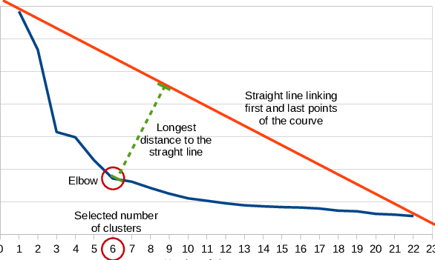
III. K-means clustering in image compression
👀 Elbow method
⤷ How to find the k that will generate the smallest WCSS?
19: https://medium0.com/analytics-vidhya/image-compression-using-k-means-clustering-and-principal-component-analysis-in-python-893fd37e8e15

Slide 35
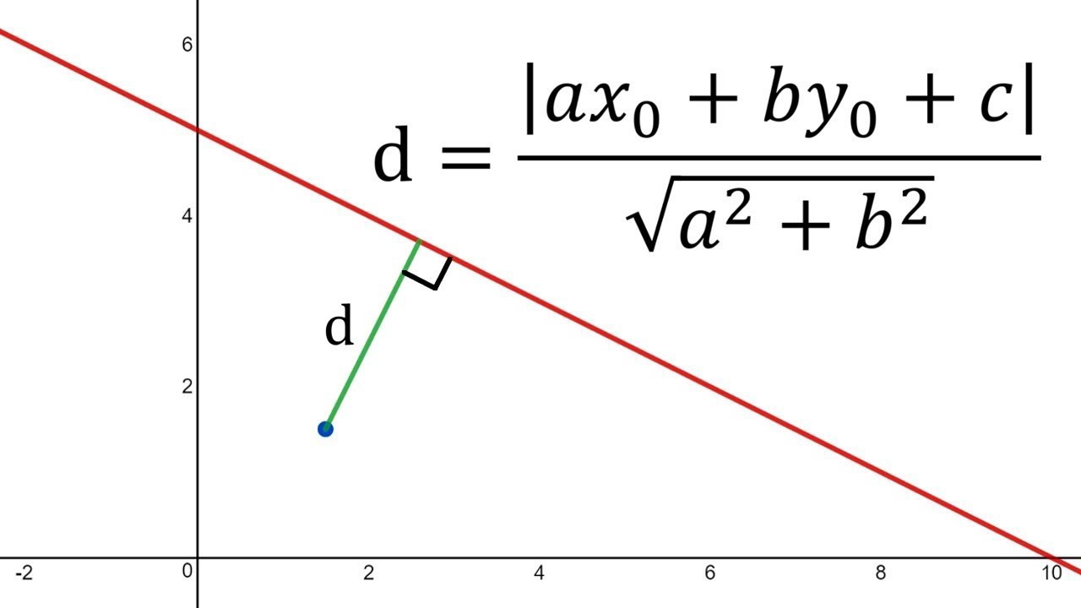
III. K-means clustering in image compression
👀 Elbow method
⤷ How to calculate the distance between a point and a straight line?
20: https://medium0.com/analytics-vidhya/image-compression-using-k-means-clustering-and-principal-component-analysis-in-python-893fd37e8e15

Slide 36
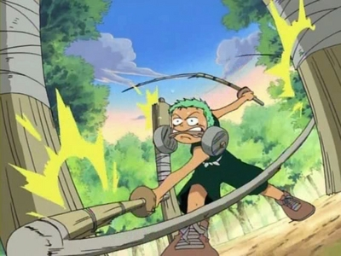
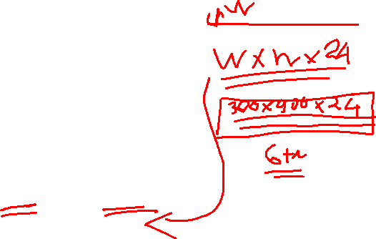
III. K-means clustering in image compression
👀 Input image
w = 300, h = 900

Slide 37

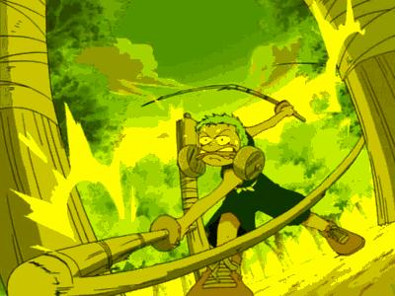
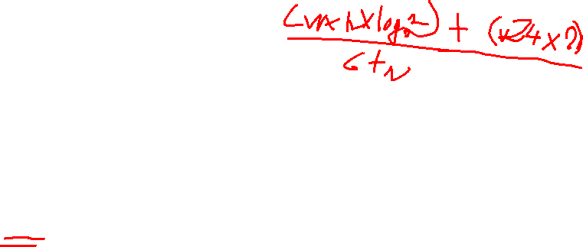
III. K-means clustering in image compression
👀 Output image
k = 2, r = 4%
k = 64, r = 25%

Slide 38
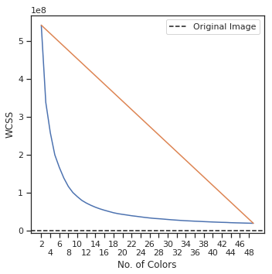
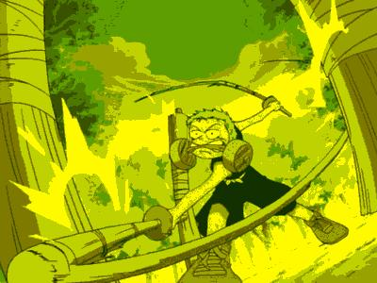
III. K-means clustering in image compression
👀 Output image
Perform Elbow method with k ranged from 2 to 48 to find the optimal k for our image.
k = 9, r = 13.2%

Slide 39
IV. Demo

Slide 40
V. Conclusion
K-means clustering algorithm can be used to compressed images.
Compressing an image using the K-means algorithm is a loss compression, which means it cannot reverse to the origin.
When K is larger, the compression ratio is larger and the contrary for lower K.
We can use Elbow Method to find the optimal k value.

Slide 41
References
[1] Kumar, Satyam. ‘Image Compression Using K-Means Clustering’. Medium, 17 June 2020, https://towardsdatascience.com/image-compression-using-k-means-clustering-aa0c91bb0eeb.
[2] Kumar, Satyam. ‘Understanding K-Means, K-Means++ and, K-Medoids Clustering Algorithms’. Medium, 15 Apr. 2021, https://towardsdatascience.com/understanding-k-means-k-means-and-k-medoids-clustering-algorithms-ad9c9fbf47ca.
[3] Agarwal, Vibhor. ‘Image Compression Using K-Means Clustering.’ Medium, 24 May 2018, https://medium0.com/@agarwalvibhor84/image-compression-using-k-means-clustering-8c0ec055103f.

Slide 42

The end

